Slide 1
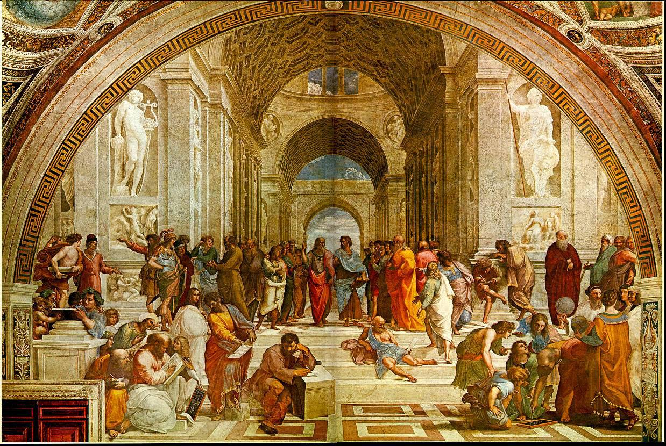
Certificate of Completion
This is to Certify that
Parker Dresdow
General P.D. Patton
Those Who Do Not Study History Are Doomed to Reread Milton -
Lying Chained to the Burning Lake
I’m down for some (VROOM) Ducati!
has successfully completed all requirements of the
Great Books Colloquium
Pepperdine University
April 26, 2019
Don Thompson
_____________________

Slide 2
Certificate of Completion
This is to Certify that
Devyn Duke
Nietzsche is my Tietzsche
Nature speaks! E = mc²
Kall me Kolya, UN Representative
Taking Flight with Song of Solomon’s Circe
has successfully completed all requirements of the
Great Books Colloquium
Pepperdine University
April 26, 2019
Don Thompson
_____________________

Slide 3
Certificate of Completion
This is to Certify that
Daniel Hu
Electio Naturalis Da mihi
I Am Chemist - Hear Me Roar
Never Lacerated, Always Thinking
Joie de Vivre: More Books to Read!
has successfully completed all requirements of the
Great Books Colloquium
Pepperdine University
April 26, 2019
Don Thompson
_____________________

Slide 4
Certificate of Completion
This is to Certify that
David Kellogg - King of Battle Creek
lingua concipiat flammam
Three Person Baby sitting on a Corn Flake
I can blow through this in 10 minutes with my Cocoa Krispies
On top of old Gauss, I met my own thesis - Frosted Flakes
I became illiterate - Now I read Wheaties Boxes
has successfully completed all requirements of the
Great Books Colloquium
Pepperdine University
April 26, 2019
Don Thompson
_____________________

Slide 5
Certificate of Completion
This is to Certify that
Elizabeth Vergilius Park
Amo, Amas, Amat Libri Maximus
One Sister with 8 Brothers K. - It’s a Fair Fight
Kinda Katya & Gentle Grushka
Bring on S. Freud, E.M. Forster, C & P, but NOT KANT
has successfully completed all requirements of the
Great Books Colloquium
Pepperdine University
April 26, 2019
Don Thompson
_____________________

Slide 6
Certificate of Completion
This is to Certify that
Brock Petty
Arizoniensis Cardinalis Bowerbird
Take me back to Heidelberg
zu dem Schloss
BK Devotee
Academic Athlete
has successfully completed all requirements of the
Great Books Colloquium
Pepperdine University
April 26, 2019
Don Thompson
_____________________

Slide 7
Certificate of Completion
This is to Certify that
Nicholas Rosenberg
Multi ergo Libri: Parva igitur Tempus
Vision 360º
Zosima in Training
Szymborska Fan - Poet Laureate
has successfully completed all requirements of the
Great Books Colloquium
Pepperdine University
April 26, 2019
Don Thompson
_____________________

Slide 8
Certificate of Completion
This is to Certify that
Derek Santolo
Zebrahead Rockstar
Kant Forever!
Living in the Spiritual World
Teleological Suspension of New Jersey
has successfully completed all requirements of the
Great Books Colloquium
Pepperdine University
April 26, 2019
Don Thompson
_____________________

Slide 9
Certificate of Completion
This is to Certify that
Blake Tinney
Omnes enim Codex
Do While {Recursive Reader};
Counting_days_until_Graduation--;
printf("Hello, World!");
Inbox has measure 0
has successfully completed all requirements of the
Great Books Colloquium
Pepperdine University
April 26, 2019
Don Thompson
_____________________

